Slide 1


Slide 2
Voytek Arkita
Principal Consultant
VOYTEK.ARKITA@oracle.com
+61406081710

Slide 3
RDF Training General Overview

Slide 4
Module 1

Slide 5
Module 1 – Introduction to Demand Forecasting
Goals for Module 1:
Review Demand Forecast concepts
Review Demand Forecasting challenges
Review Demand Forecasting architecture

Slide 6
What is Demand Forecasting?
Oracle Demand Forecasting is a statistical
forecasting solution that generates extremely
accurate forecasts of demand as automatically
as possible by using a variety of predictive
techniques.

Slide 7
Forecasting Overview
Problem: Reactive Replenishment
When demand and supply are not lined up:
Experience lost sales
Excessive inventory
Solution: Predictive Replenishment
Reduce lost sales
Reduce excessive inventory

Slide 8
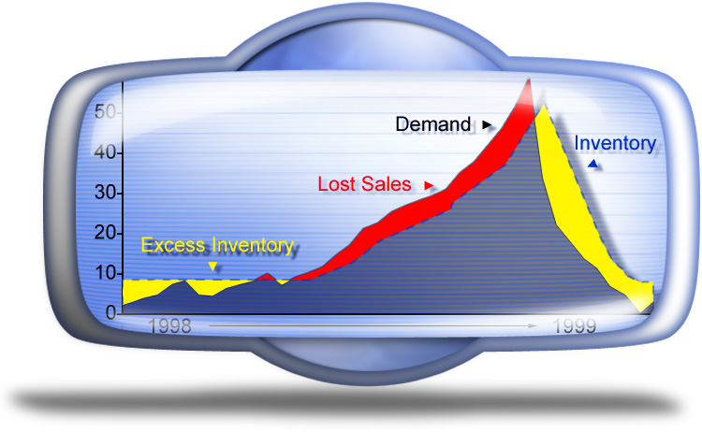
Forecast Overview

Slide 9
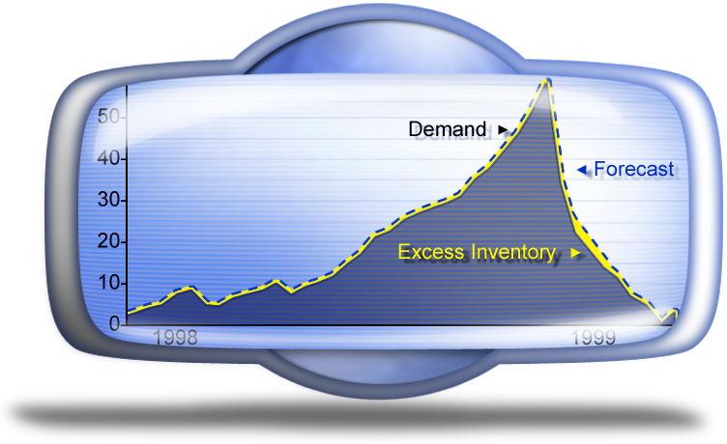
Forecast Overview

Slide 10
Hierarchies
Total
“Country”
Year
“Department”
State
“Season / Half”
Class
Store
“Quarter”
Category
Month
Group
Week
SKU
May include Alternate Hierarchies (yet to be defined)

Slide 11
Forecasting Challenges : Overcoming Data Sparsity
Sparsity = Noisy, Muddled, Sporadic.
POS data is typically sparse:
Item / Store / Day
Item / Store / Week

Slide 12



Forecasting Challenges : Overcoming Data Sparsity
Source Level Forecast provides the ability to overcome data sparsity at a base level, until meaningful trends or patterns are more evident
Notes:
38
2
1

Slide 13
Forecasting Challenges : Overcoming Data Sparsity
Final Level vs. Source Level Forecasting
Source Level Forecasts are the levels to which
data is aggregated, and from which a forecast is
generated. Examples:
SKU > Chain > Week
Subclass > Chain > Week
Category > Chain > Week
TGG Source Level
Store > Category > Week
Store > Group > Week
Store > SKU (core) > Week
Notes:
38
2
1

Slide 14
Forecasting Challenges : Overcoming Data Sparsity
Final Level Forecasts are the levels to which the
source forecasts are spread. Examples:
Sku > Store > Week
Sku > Store > Day
Spreading the data from a Source level to a Final
level is a helpful forecasting technique that helps
provide more accurate forecasts when data at the
lowest levels is sparse and/or “noisy.”
Final Level vs. Source Level Forecasting cont.

Slide 15
Forecasting Challenges : Overcoming Data Sparsity
Final Level vs. Source Level Forecasting cont.
2 . Data is ‘smoother’, and better suited for an accurate forecast.
3 . Forecast is generated, based on recent demand.
X
2 5 1 7 3 2 1 1 2 12
X
8 4 3 2 2 2 1 1 2 2
1 . Item level data is sparse, erratic. Data is aggregated to a higher level.
4. The source level forecast is spread back to the final level using a “ratio profile”.
a
0 1 0 4 0 0 0 1 1 1
a
2 1 1 0 0 0 0 1 1 0
b
0 1 1 2 2 2 0 0 1 1
b
2 1 1 1 0 2 0 0 1 1
c
1 1 0 0 0 0 0 0 0 1
c
0 0 0 1 0 0 0 0 0 1
d
0 1 0 1 1 0 1 0 0 1
d
2 1 1 0 1 0 1 0 0 0
e
1 1 0 0 0 0 0 0 0 8
e
2 1 0 0 1 0 0 0 0 0

Slide 16
Forecasting Challenges : Overcoming Data Sparsity
Final Level vs. Source Level Forecasting cont.
Source Level Forecasts are spread using a ratio profile or “Curve”.
These profiles are available to RDF in one of three ways:
The Interim forecast (creates a dynamic profile % based on a comparison of an interim final level forecast and the source forecast).
Profiles are loaded from external system.
Custom Profiles levels are set up during configuration. Custom profiles can be accessed and manipulated through Curve.
3 . Forecast is generated, based on recent demand.
X
8 4 3 2 2 2 1 1 2 2
4. The source level forecast is spread back to the final level using a “ratio profile”.
a
2 1 1 0 0 0 0 1 1 0
b
2 1 1 1 0 2 0 0 1 1
c
0 0 0 1 0 0 0 0 0 1
d
2 1 1 0 1 0 1 0 0 0
e
2 1 0 0 1 0 0 0 0 0
Notes:
58
26
24

Slide 17
Forecasting Challenges
Selecting the best forecast method
Simple Exp. Smoothing
Simple Exp. Smoothing
Intermittent Exp. Smoothing
Intermittent Exp. Smoothing
Trend Exp. Smoothing
Trend Exp. Smoothing
Auto ES
Additive Seasonal Exp. Smoothing
Additive Seasonal Exp. Smoothing
Multiplicative Seasonal Exp. Smoothing
Bayesian
Causal
Notes:
56
6
5
24
25

Slide 18
Forecasting Challenges
Selecting the best forecast method
Simple Exp. Smoothing
Simple Exp. Smoothing
ES stands for Exponential Smoothing.
Exponential Smoothing allows RDF to consider long historical horizons, but to still weight more recent history with more relevance.
Intermittent Exp. Smoothing
Intermittent Exp. Smoothing
Trend Exp. Smoothing
Trend Exp. Smoothing
Auto ES
Additive Seasonal Exp. Smoothing
Additive Seasonal Exp. Smoothing
Multiplicative Seasonal Exp. Smoothing
Bayesian
Causal
Notes:
38
2
1

Slide 19
Forecasting Challenges
Selecting the best forecast method
The ES forecasting family seeks to quantify:
Level
Trend
Seasonality
AutoES competes the forecasting methods against each other, and selects the method that yields the best fit considering the data available.
Simple Exp. Smoothing
Simple Exp. Smoothing
Intermittent Exp. Smoothing
Intermittent Exp. Smoothing
Trend Exp. Smoothing
Trend Exp. Smoothing
Auto ES
Additive Seasonal Exp. Smoothing
Additive Seasonal Exp. Smoothing
Multiplicative Seasonal Exp. Smoothing
Bayesian
Causal

Slide 20
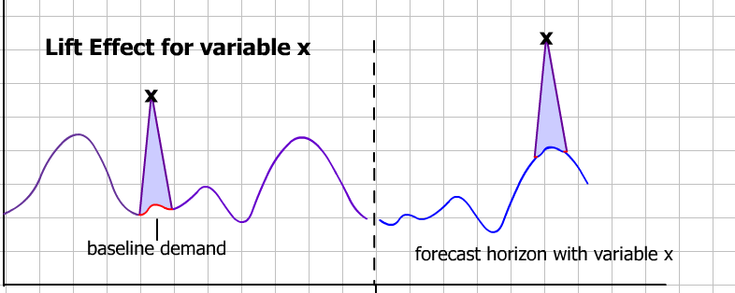
Forecasting Challenges
Causal Forecasting:
Causal Forecasting provides the ability to quantify the effects that promotional variables have on the baseline consumer demand.
Notes:
38
2
1

Slide 21
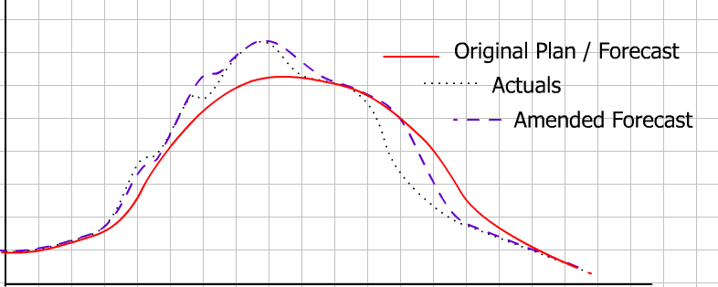
Forecasting Challenges
Bayesian Forecasting
Bayesian forecasting provides the ability to “marry” an established forecast with actual consumer sales.
Example: Within week re-forecast at day level
A plan is used in conjunction with a demand forecast…

Slide 22



Forecasting Challenges
Forecasting new products and locations
Miami Forecast History
Solutions: RDF allows the system to use data from a similar “sister” store for forecasting purposes until the New Store has enough historical data for an accurate forecast.

Slide 23
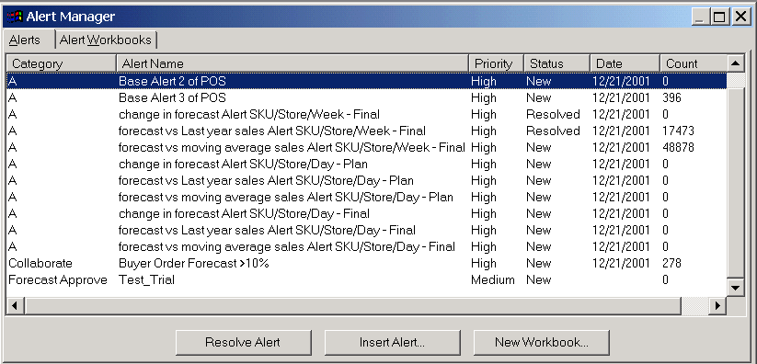
Forecasting Challenges
Automated exception reporting
200 stores x 5000 active item x 13 week horizon = 13,000,000 forecast values.
Exception Reporting is critical.
Example:
Super User:
Category and Group
alerts
Category Planner:
SKU alerts

Slide 24
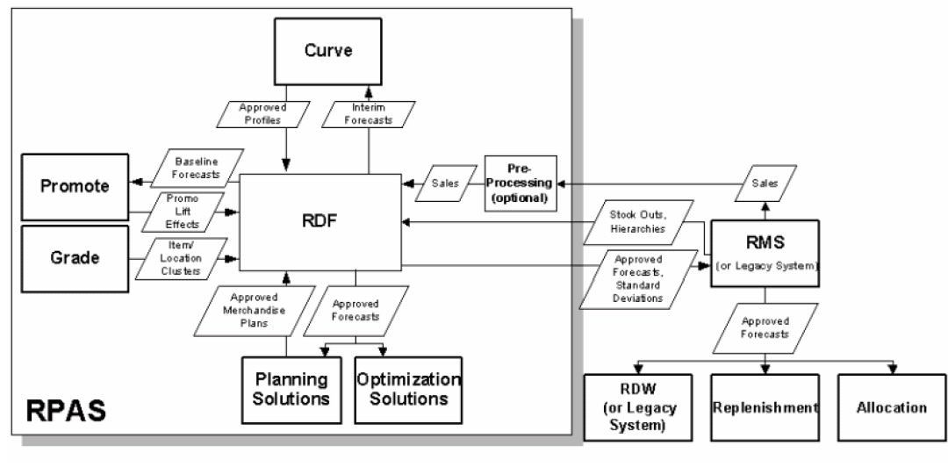
Demand Forecasting and the Oracle Enterprise

Slide 25

Interface overview
Batch process can be executed on a weekly or daily basis
Exported during batch process
BI/DW
Org. Hierarchy
Reg. Sales
Product Hierarchy
Promo Sales
Sales loaded on a Weekly or Daily level
Clearance Sales
Approved Forecast
MFP
Forecast export
RDF
Forecast can be exported daily, weekly, monthly, or upon request.

Slide 26
RDF Primary Workflow
Preprocess Data
Set Forecast Defaults
Override Defaults by Product / Location
Generate Forecast
Automatic Approval
Forecast Simulation
Review Exceptions and Approve Forecast
= Weekly / Daily Tasks
No
Approve by Alert
= Ad hoc Task
Yes
Forecast Accuracy Analysis
= Automated Task
Export Forecast

Slide 27

RDF Primary Workflow
Who are the potential users of RDF?
Although every client may elect to map RDF process tasks differently, this is a generic grouping of tasks for three user types:
Super Users:
Set Default Forecast Parameters
Override Forecast Parameters
Manipulate Alert Thresholds
Modify Sales History
Review forecast exceptions
Modify User Def Hierarchies
Forecast Scorecard
Interactive Simulation
Approve Forecasts
High Level Alerts Category/Group
Category Planner:
Override Forecast Parameters
Modify Sales History
Review forecast exceptions
Modify User Def Hierarchies
Approve Forecasts
Low Level Alerts SKU level
IT Admin:
Create Users
Create Passwords
Workbook Security
Domain Management:
Batch Runs
Data Load

Slide 28
Module 2

Slide 29
Module 2 – Preparing Data for Forecasting
Topics for Module 2:
Preprocessing Overview
Automated Preprocessing
Manual Sales Adjustments

Slide 30
Preprocessing Data in the RDF Workflow
Set Forecast Defaults
Override Defaults by Product / Location
Preprocess Data
Generate Forecast
Automatic Approval
= Weekly / Daily Tasks
Review Exceptions and Approve Forecast
Forecast Simulation
No
Approve by Alert
= Ad hoc Task
Yes
= Automated Task
Forecast Accuracy Analysis
Export Forecast

Slide 31
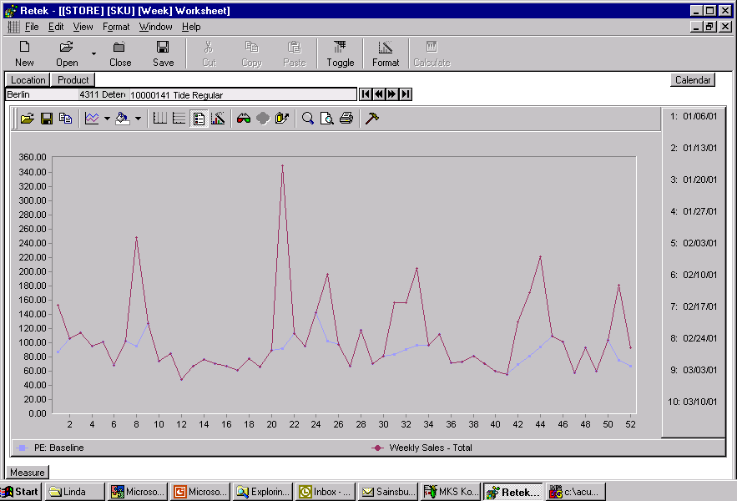
Preparing Data for Forecasting
Automated Preprocessing:
“Garbage In = Garbage Out”
Accuracy of forecast is directly tied to the quality and integrity of data on which the forecast is based.
Preprocessing “smoothes” data in one of two ways:
Automated Preprocessing
Manual Adjustment of Sales History

Slide 32
Preparing Data for Forecasting
Automated Preprocessing:
There are a number of preprocessing approaches:
Smooth over identified points only (multiple methods)
Identify Promotions for Historical Baseline
Stock outs for Lost Sales Calculations
Smooth over all points (multiple methods)
Lost Sales Calculations
Forecast Sigma Method
Uses deviation from Approved or Fitted Forecast.
Removes outliers that cannot be explained

Slide 33
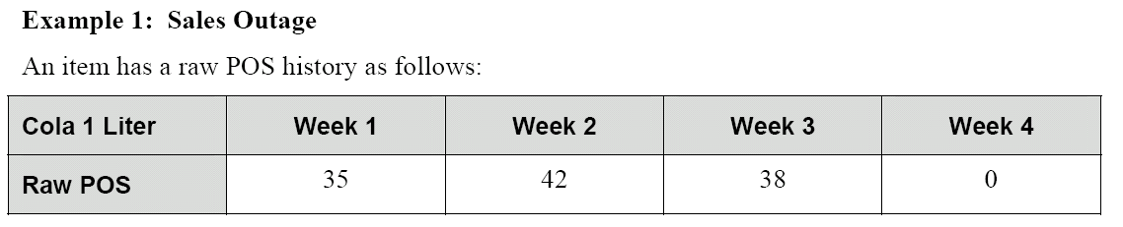
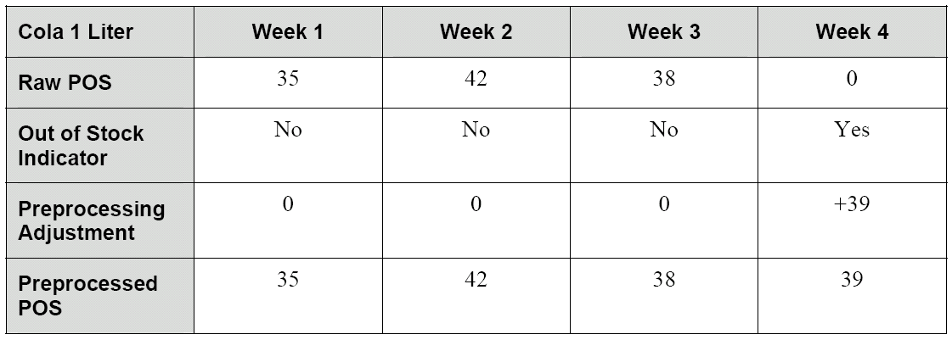
Preparing Data for Forecasting
Automated Preprocessing:
Preprocessing…
*
* Out of Stock Indicator will be a manual input for TGG.

Slide 34
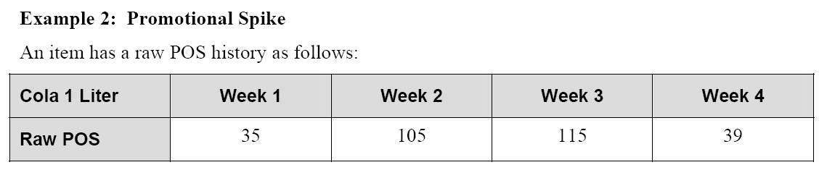
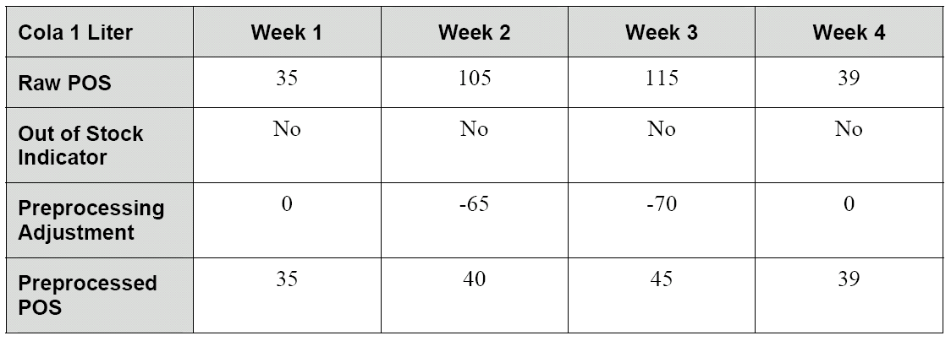
Preparing Data for Forecasting
Automated Preprocessing:
Preprocessing…
*
* Out of Stock Indicator will be a manual input for TGG.

Slide 35
Preparing Data for Forecasting
Manual Adjustment of Sales History
Potential Reasons:
Fake History is needed
Smoothing spikes or dips in pos data
Manually creating a lift effect

Slide 36
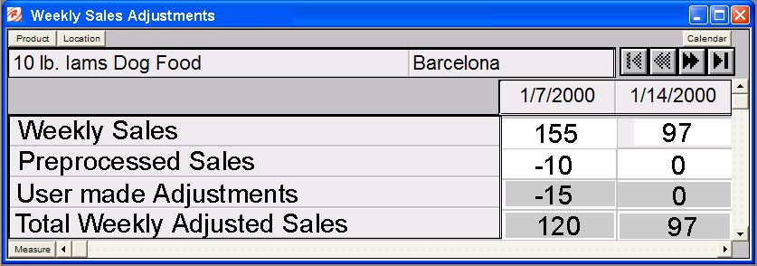
Preparing Data for Forecasting
Manual Adjustment of Sales History
Example of a Weekly Sales Adjustment Worksheet.
Non-Writeable Measures
Writeable Measures

Slide 37
Module 3

Slide 38
Module 3 – Setting Forecast Parameters
Topics for Module 3:
Review Forecast Methods
Review, build, and adjust Forecast Administration Parameters
Review, build, and adjust Forecast Maintenance Parameters
Review, build, and adjust Like Item / Sister Store Parameters

Slide 39
Setting Forecast Defaults in the RDF Workflow
Set Forecast Defaults
Override Defaults by Product / Location
Preprocess Data
Generate Forecast
Automatic Approval
= Weekly / Daily Tasks
Review Exceptions and Approve Forecast
Forecast Simulation
No
Approve by Alert
= Ad hoc Task
Yes
= Automated Task
Forecast Accuracy Analysis
Export Forecast

Slide 40
Setting Forecast Parameters
Forecast Administration Workbook:
The Forecast Administration Workbook is used to set up the default forecasting parameters across the whole domain.
The parameters will need to be set for both final level forecast settings and source level settings.

Slide 41
Setting Forecast Parameters
Forecast Administration Workbook:
Forecasting Methods:
Simple Exp. Smoothing
Simple Exp. Smoothing
Intermittent Exp. Smoothing
Intermittent Exp. Smoothing
Trend Exp. Smoothing
Trend Exp. Smoothing
Auto ES
Additive Seasonal Exp. Smoothing
Additive Seasonal Exp. Smoothing
Multiplicative Seasonal Exp. Smoothing
Bayesian
Causal

Slide 42
RDF Forecasting Methods
Exponential Smoothing Family:
Auto ES:
Simple ES
Simple / Intermittent ES
Trend ES
Seasonal ES
Multiplicative Seasonal
Additive Seasonal
Seasonal Regression
Bayesian
Like Sku / Sister Store
Causal
Average
None

Slide 43
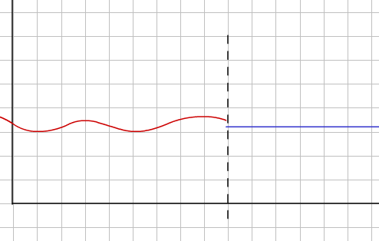
RDF Forecasting Methods
Simple ES, Simple / Intermittent ES:
The Simple ES method will result in a forecast that only quantifies the LEVEL of the historical time series.
Simple / Intermittent ES will produce a Simple ES forecast in the event that there are zeroes in the historical time series.

Slide 44
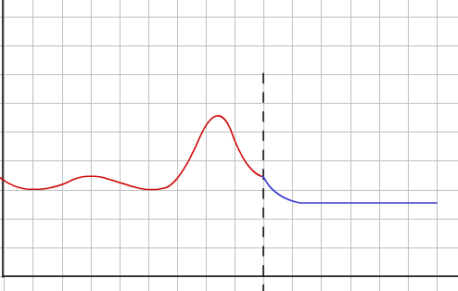
RDF Forecasting Methods
Trend ES:
The Trend ES method will result in a forecast that quantifies both the LEVEL and TREND of the historical time series.

Slide 45
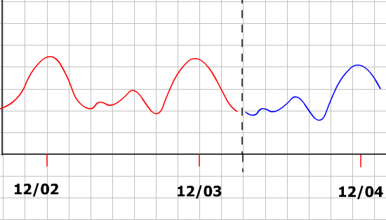
RDF Forecasting Methods
Seasonal ES:
The Seasonal ES method will result in a forecast that quantifies both the LEVEL and TREND and SEASONALITY of the historical time series.
The Seasonal ES method can consider Multiplicative seasonality (where seasonality has multiplicative effects), Additive (where seasonality has zeroes in the history), or Season Regression.

Slide 46
RDF Forecasting Methods
Auto ES:
A primary goal for a demand forecasting solution is automation.
Auto ES is a proprietary forecasting algorithm that competes the varying ES methods against each other for goodness of fit.

Slide 47
RDF Forecasting Methods
Bayesian Forecasting:
Bayesian Forecasting Formula Demo

Slide 48

RDF Forecasting Methods
Like Sku / Sister Store:
Used to generate for forecasts for new items based on an existing item’s history.
Used to create forecasts for a whole store, or item at a store, based off another store’s history.

Slide 49
RDF Forecasting Methods
Causal Forecasting:
Causal Forecasting quantifies the lift effect (positive, negative, or neutral) of a given causal variable on the time series.
This lift effect can be used to calculate the lift effect on the forecast where the same causal variable exists.

Slide 50
TGG Promotions
Causals are used to generate promotional forecasts
High level causals will be used for a simple configuration for example
Base catalogues
CTA
Media
To be confirmed: Interest Free and VIP Nights
Others/placeholder
Causals are dependent on historical availability
Causals will be applied to Core and K SKUs

Slide 51
RDF Forecasting Methods
Average:
Based the forecast on the average level of the time series.
None:
Forecasting can be turned ‘off’ for those items that no longer need forecasts generated.

Slide 52
Setting Forecast Parameters
Forecast Administration Workbook:
Demo

Slide 53
Overriding Forecast Defaults in the RDF Workflow
Set Forecast Defaults
Override Defaults by Product / Location
Preprocess Data
Generate Forecast
Automatic Approval
= Weekly / Daily Tasks
Review Exceptions and Approve Forecast
Forecast Simulation
No
Approve by Alert
= Ad hoc Task
Yes
= Automated Task
Forecast Accuracy Analysis
Export Forecast

Slide 54
Setting Forecast Parameters
Workbooks used to override default settings:
The Forecast Maintenance Workbook is used to override default forecasting parameters.
The Like Item / Sister Store Worksheet is used to set up forecasts for new items, like items, new stores, etc.
DEMO

Slide 55
Module 4

Slide 56
Module 4 – Generating and Approving a Forecast
DEMO

Slide 57
Generating and Approving the Forecast in the RDF Workflow
Set Forecast Defaults
Override Defaults by Product / Location
Preprocess Data
Generate Forecast
Automatic Approval
= Weekly / Daily Tasks
Review Exceptions and Approve Forecast
Forecast Simulation
No
Approve by Alert
= Ad hoc Task
Yes
= Automated Task
Forecast Accuracy Analysis
Export Forecast

Slide 58
Module 5

Slide 59
Module 5 – Forecast Analysis Tools
Goals for Module 5:
Review Forecast Analysis Tools in RDF
Review, build, and execute an Interactive Forecast
Review, build, and analyze a Forecast Scorecard

Slide 60
Preprocessing Data in the RDF Workflow
Set Forecast Defaults
Override Defaults by Product / Location
Preprocess Data
Generate Forecast
Automatic Approval
= Weekly / Daily Tasks
Review Exceptions and Approve Forecast
Forecast Simulation
No
Approve by Alert
= Ad hoc Task
Yes
= Automated Task
Forecast Accuracy Analysis
Export Forecast

Slide 61
Forecast Analysis Tools
Overview:
RDF provides two analysis workbooks:
Interactive Forecasting
Forecast Scorecard
DEMO

Slide 62
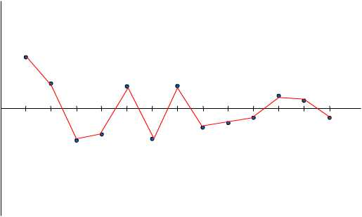
Forecast Analysis Tools
Forecast Scorecard:
Actuals vs. Forecasts Worksheet
Over time, if analysis and ongoing maintenance is give to RDF, this measure of error should continue to reduce.
+30
+20
+10
0
-10
-20
-30

Slide 63
Module 6

Slide 64
Module 6 – Promotional Forecasting
Goals for Module 6:
Review Promotional Forecast Concepts
Review and build a Promotion Planner Workbook
Review and build a Promotion Maintenance Workbook
Review and configure a Causal Forecast

Slide 65
Using Promote in the RDF Workflow
Set Forecast Defaults
Override Defaults by Product / Location
Preprocess Data
Generate Forecast
Automatic Approval
Promotional Planning
= Weekly / Daily Tasks
Review Exceptions and Approve Forecast
Causal Maintenance
Approve by Alert
No
= Ad hoc Task
Forecast Simulation
Yes
= Automated Task
Forecast Accuracy Analysis
Export Forecast

Slide 66
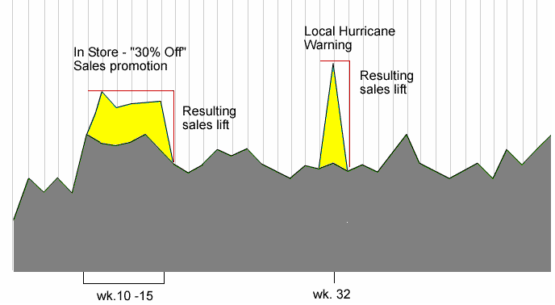
Promotional Forecasting
Overview:
Promotional Forecasting Terminology and Workflow
Promote creates a seasonal model for the historical time series, and compares it against actual sales. Where known causal events are indicated, the lift effect is quantified.
Media
Example:
CTA
Media
VIP
Local
CTA

Slide 67
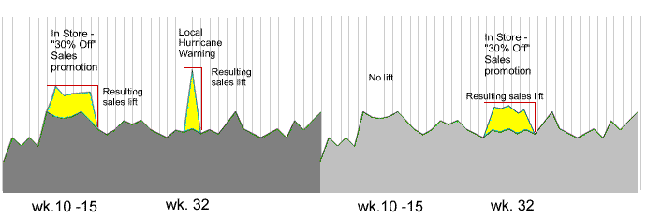
Promotional Forecasting
Overview:
Promotional Forecasting Terminology and Workflow
Where the same causal indicator is encountered in the forecast horizon, Promote will apply the correlating lift effect to the appropriate point in the time series.
CTA
Media
CTA
Sales History
Forecast

Slide 68
Promotional Forecasting
Overview:
Promote Workbooks and Wizards
DEMO

Slide 69
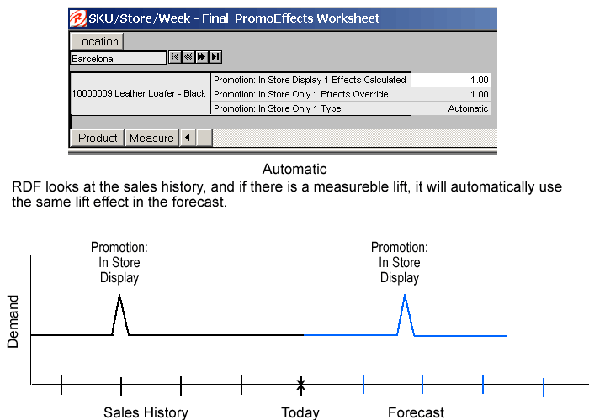
Promotional Forecasting
Promotion Maintenance Workbook:
Final PromoEffects Worksheet Measures:

Slide 70
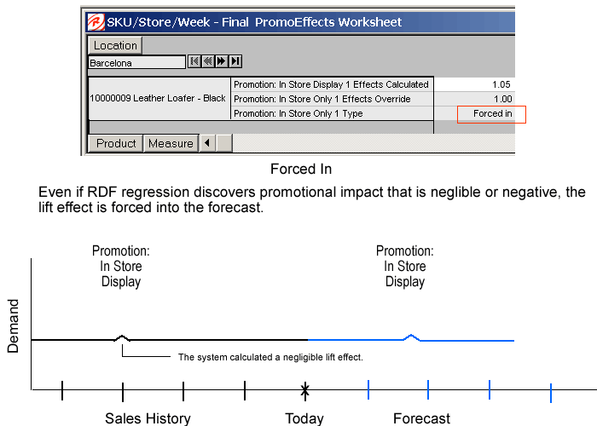
Promotional Forecasting
Promotion Maintenance Workbook:
Final PromoEffects Worksheet Measures:

Slide 71
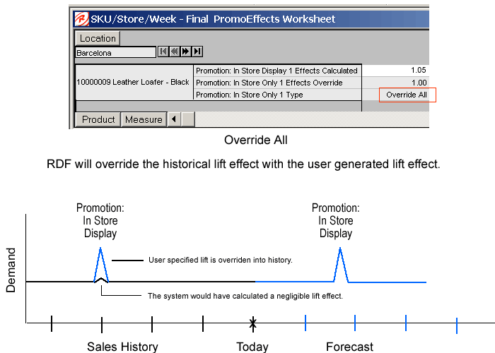
Promotional Forecasting
Promotion Maintenance Workbook:
Final PromoEffects Worksheet Measures:

Slide 72
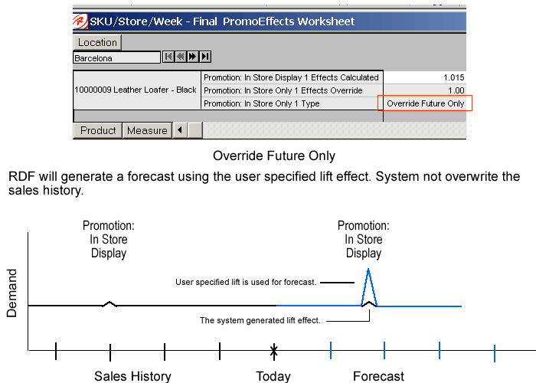
Promotional Forecasting
Promotion Maintenance Workbook:
Final PromoEffects Worksheet Measures:

Slide 73
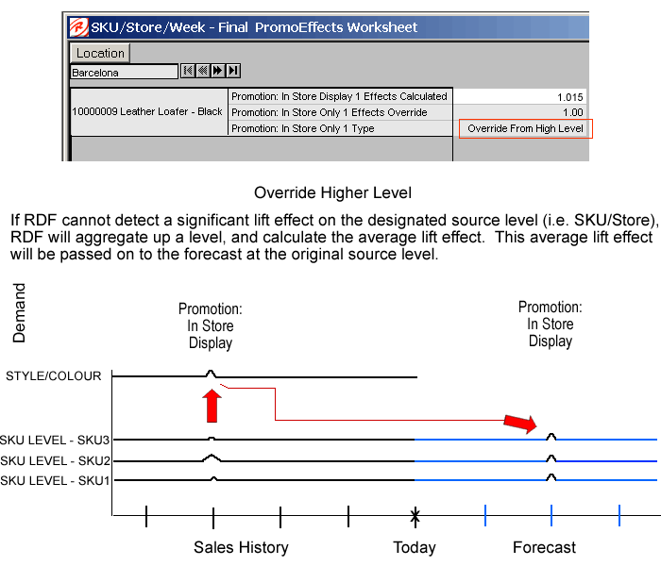
Promotional Forecasting
Promotion Maintenance Workbook:
Final PromoEffects Worksheet Measures:

Slide 74
Module 7

Slide 75
Module 7 – Profile Generation using Curve
Goals for Module 7:
Review Profile Generation Concepts
Review and build Profile Administration Workbook
Review and build Profile Maintenance Workbook
Review and build Profile Approval Workbook

Slide 76
Using Curve in the RDF Workflow
Curve
Set Forecast Defaults
Override Defaults by Product / Location
Preprocess Data
Generate Forecast
Automatic Approval
Promotional Planning
= Weekly / Daily Tasks
Review Exceptions and Approve Forecast
Causal Maintenance
Approve by Alert
No
= Ad hoc Task
Forecast Simulation
Yes
= Automated Task
Forecast Accuracy Analysis
Export Forecast

Slide 77
Using Curve in the RDF Workflow
Curve
Set Forecast Defaults
Override Defaults by Product / Location
Preprocess Data
Generate Forecast
Profile Generation and Maintenance Workflow
Automatic Approval
Promotional Planning
Review Exceptions and Approve Forecast
= Weekly / Daily Tasks
Configure Profile Admin.
Configure Profile Maintenance
Run Profile Batch
Adjust and Approve Profile
Causal Maintenance
Approve by Alert
No
= Ad hoc Task
Forecast Simulation
Yes
= Automated Task
Forecast Accuracy Analysis
Export Forecast

Slide 78
Profile Generation using Curve
Example of profiles:
Category -> SKU
Group -> SKU
Week -> Day
DEMO

Slide 79
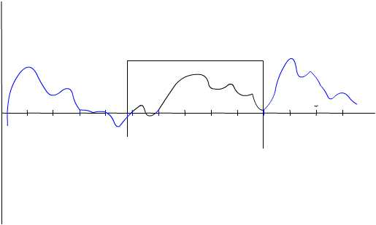
Profile Generation using Curve
Profile Generation Techniques:
Adjusting the training window.
In some cases, not all historical information available should be considered for the profile.
Example: When creating a Summer Color Profile, the training window should only consider those dates that comprise a summer season.
Training Window

Slide 80
Q
&
A

